Slide 1
Multiprocessors

Slide 2
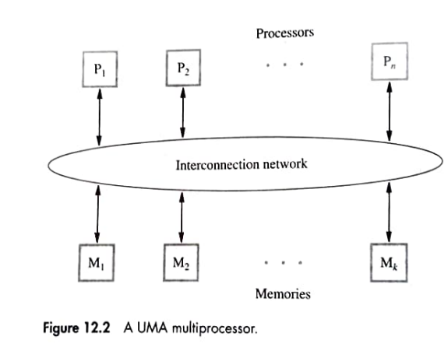
The Structure of general purpose multiprocessors

Slide 3
UMA
Permits n processors to access k memories
Interconnection network may introduce a delay
If delay is same for all accesses to memory, such a machine is called uniform memory access
.

Slide 4
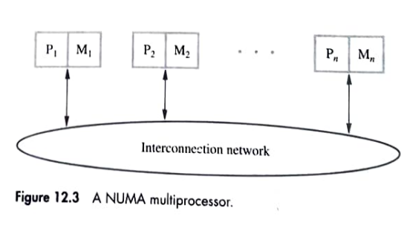
NUMA

Slide 5
NUMA
Attach a memory module directly to the processor
Processor can also access other memories, which will be longer than access to the local memory
Such a machine is called Non uniform memory access
.

Slide 6
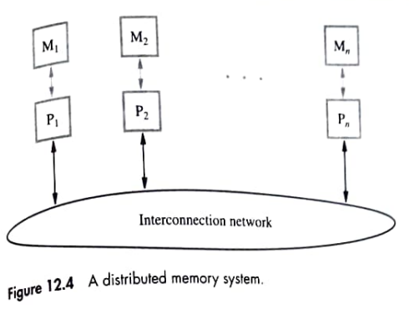
Distributed Memory System

Slide 7
Distributed Memory System
All memory module serve as private memory for the processor
A processor access a remote memory by exchanging messages to the processor
Such a system is called distributed-memory systems with a message-passing protocol
.

Slide 8
Interconnection Networks
Suitability of a network
Cost
Bandwidth – Capacity of a transmission link to transfer data (bits or bytes per second)
Throughput – Rate if data transfer
Ease of implementation

Slide 9
Single Bus
Bus transfer take T time units, memory access time is 4T units
Split-Transaction protocol – use the bus in the idle period to serve another request
Disadv – the number of modules connected to the bus is not large

Slide 10
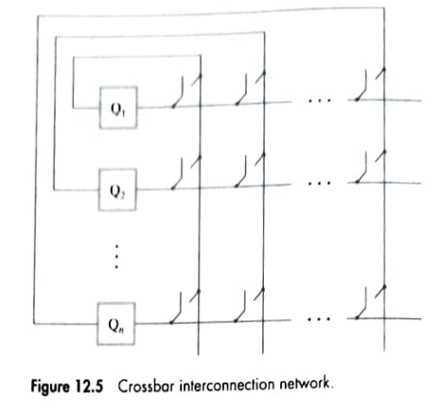
Crossbar Networks

Slide 11
Crossbar Networks
Fully connected network – Any module can be connected to any other module by closing an appropriate switch
Also called non-blocking switch

Slide 12
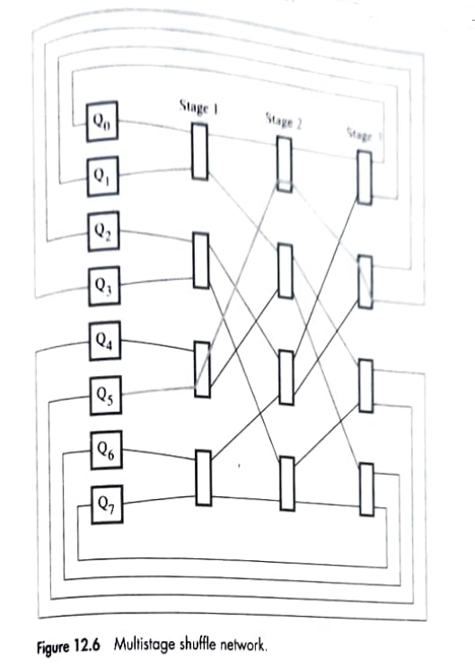
Multistage Networks

Slide 13
Multistage Networks
Less costly
Large number of parallel paths between sources and destinations

Slide 14
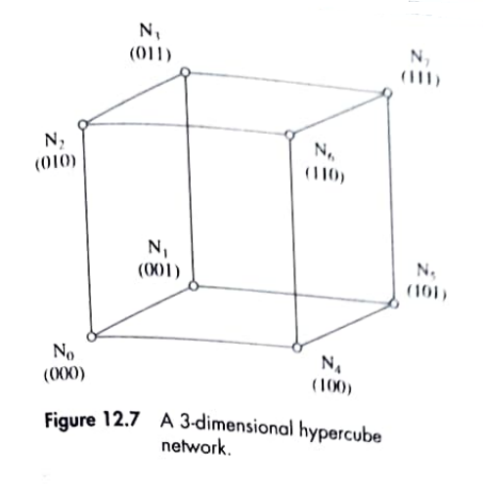
Hypercube Networks

Slide 15
Hypercube Networks
N-dimensional cube that interconnects 2^{n} nodes
Each node is directly connected to n neighbors
Label nodes by binary address
Send message to all neighbors
Maximum distance that the message need to travel is n hops

Slide 16
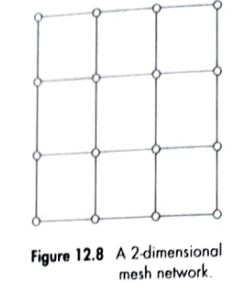
Mesh Networks

Slide 17
Mesh Networks
Link between the nodes are bidirectional
For routing, first the transfer takes place in horizontal direction and then in vertical direction

Slide 18
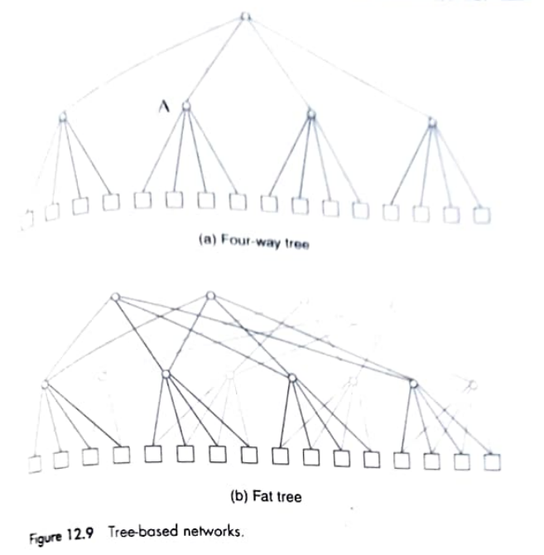
Tree Networks

Slide 19
Tree Networks
4 way tree that interconnects 16 modules
Each parent node allows communication between 2 of its children at a time
Fat tree network
Number of links in the upper levels of the tree hierarchy

Slide 20
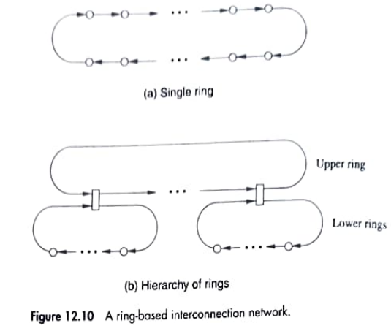
Ring Networks

Slide 21
Ring Networks
Easy to implement
Short rings reduces the latency of transfer
Hierarchy of rings

Slide 22
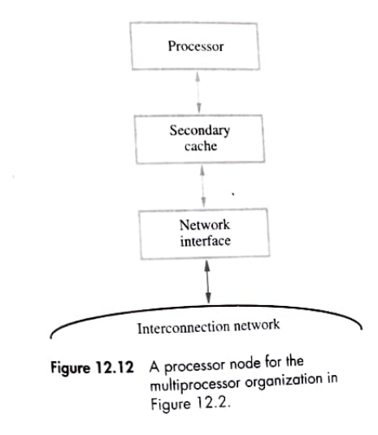
Memory Organization

Slide 23
Memory Organization
Processor include primary cache and secondary cache
Single global address space where a range of physical address is assigned to each memory module

Slide 24
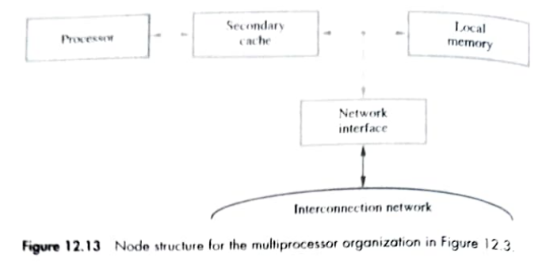
Memory Organization

Slide 25
Memory Organization
NUMA – each node contain a processor and portion of the memory
Each memory module constitutes the private address space of that processor

